Slide 1
Data Mining
Ch 6: Mining Frequent Patterns, Associations, and Correlations - 3
Wan D. Bae, Ph.D.
baewd@hanyang.ac.kr

Slide 2
Scalable Frequent Itemset Mining Methods
Apriori: A Candidate Generation-and-Test Approach
Improving the Efficiency of Apriori
FPGrowth: A Frequent Pattern-Growth Approach
Apriori의 한계점 ?
상당한 수의 후보집합을 생성해야 하고, 후보집합 검사와 지지도 결정을 위해서 전체 DB를 반복해서 스캔해야함.
=>해결 : 빈발 패턴 성장…(분할정복 기법 사용)
항목집합 연관정보를 상실하지 않으면서,
1.빈발항목을 갖는 DB를 빈발패턴 트리로 압축한다.
2.압축한 DB를 조건부 DB집합으로 분할하고,개별 빈발항목(패턴 조각)과 연계시켜 개별적으로 마이닝한다.
3.개별 패턴조각,즉 연관된 데이터 집합만 조사하면 된다.

Slide 3
Mining Frequent Patterns without Candidate Generation
DFS는 스택(쭉 들어가고,더이상 들어갈곳이 없을 때 이전노드로 돌아가고,인접하면서 방문하지않은 노드를 찾는다.)
BFS는 큐(인접한 노드를 모두 큐에 집어넣는다.인접한 노드를 큐에 다넣었다면, 큐에서 dequeue하고 dequeue한 노드의 인접한 노드 역시 enqueue한다.
Bottlenecks of the Apriori approach
  Breadth-first (i.e., level-wise) search
  Candidate generation and test
    Often generates a huge number of candidates
The FPGrowth Approach (J. Han, J. Pei, and Y. Yin, SIGMOD’ 00)
  Depth-first search
  Allows frequent itemset discovery without candidate itemset generation.
  Grow long patterns from short ones using local frequent items only
  Example:
    “abc” is a frequent pattern
    Get all transactions having “abc”: DB|abc
    “d” is a local frequent item in DB|abc → abcd is a frequent pattern

Slide 4
Mining Frequent Patterns with FP-trees
Idea: Frequent pattern growth
  Recursively grow frequent patterns by pattern and database partition
Method
  For each frequent item, construct its (1) conditional pattern-base, and then (2) its conditional FP-tree
    Repeat the process on each newly created conditional FP-tree
  Until the resulting FP-tree is empty, or it contains only one path—single path will generate all the combinations of its sub-paths, each of which is a frequent pattern
  Two step approach:
    Step 1: Build a FP-tree, a compact data structure
      built using 2 passes over the data set
    Step 2: Extracts frequent itemsets directly from FP-tree
      Traversal through FP-tree

Slide 5
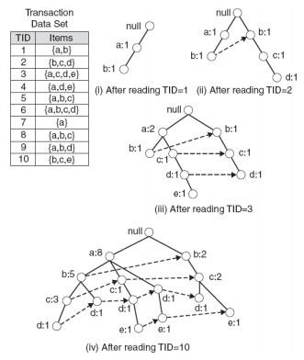
FP-Tree: Core Data Structure
  Nodes correspond to items and have a counter
  FP-Growth reads 1 transaction at a time and maps it to a path
  Fixed order is used, so paths can overlap when transactions share items (when they have the same prefix)
    Counters are incremented
  Pointers are maintained between nodes containing the same item, creating singly linked lists (dotted lines) 원래있던것->새로운것 방향
  The more paths that overlap, the higher the compression.
  Frequent items are extracted from the FP-Tree

Slide 6

Step 1: FP-Tree Construction
FP-Tree is constructed using 2 passes over the data set
Pass 1 on DB:
  Scan data and find support count for each item
  Discard infrequent items (< min_support)
  Sort frequent items in decreasing order based on their support
    For our example: a, b, c, d, e
    Use this order when building the FP-Tree, so common prefixes can be shared
Transaction data

Slide 7
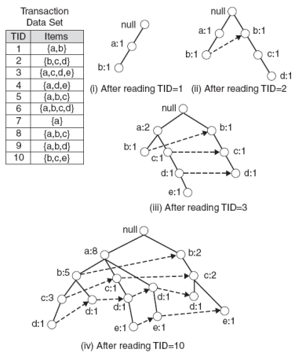
Step 1: FP-Tree Construction
Pass 2 on DB: construct the FP-Tree
Read transaction 1: {a, b}
Create 2 nodes a and b and the path null → a →b. Set counts of a and b to 1
Read transaction 2: {b, c, d}
Create 3 nodes for b, c, and d and the path null → b → c → d. Set counts to 1.
Note: although transaction 1 and 2 share b, the paths are disjoint as they don’t share a common prefix. Add the link between the b’s (dotted line).
Read transaction 3: {a, c, d, e}
It shares common prefix item a with transaction 1 so the path for transaction 1 and 3 will overlap and the frequency count for node a will be incremented by 1. Add links between the c’s and d’s.
Continue until all transactions are mapped to a path in the FP-tree.

Slide 8
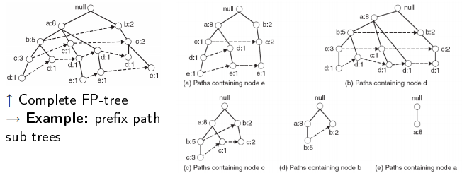
Step 2: Frequent Itemset Generation
FP-Growth extracts frequent itemsets from the FP-tree
Bottom-up algorithm – from the leaves toward the root
  Divide and conquer: first look for frequent itemsets ending in e, then de, then cde, etc.
First, extract prefix path sub-trees ending in an itemset (use the linked lists) → Update support count of each item
=>만약 infrequent라면,remove

Slide 9
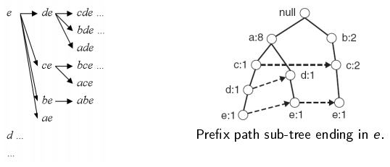
Step 2: Frequent Itemset Generation
Each prefix path sub-tree is processed recursively to extract the frequent itemsets. Solutions are then merged.
  E.g. frequent itemsets extracted from the prefix path sub-tree in e, then in de, ce, be, ae, then in cde, bde, ade, etc.

Slide 10
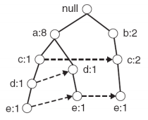
Example
Let minSup = 2 and extract all frequent itemsets containing e :
1. Obtain the prefix path sub-tree for e :
2. Check if e is a frequent item by adding the counts along the linked list (dotted line). If so, extract it.
3. As e is frequent, find frequent itemsets ending in e, i.e., de, ce, be, ae
Decompose the problem recursively
To do this, we must first to obtain the conditional FP-tree for e

Slide 11
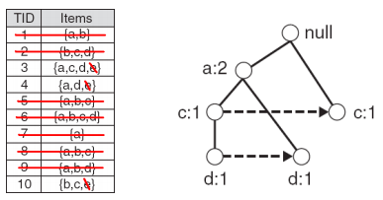
Conditional FP-Tree
The FP-Tree that would be built if we only consider transactions containing a particular itemset (and then removing that itemset from all transactions)
Example: Conditional FP-tree on e

Slide 12
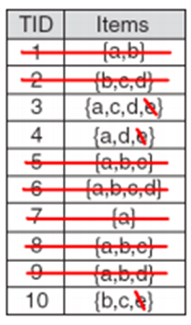
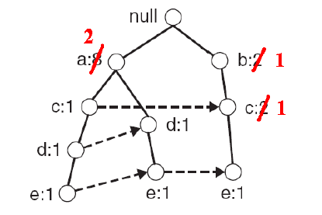
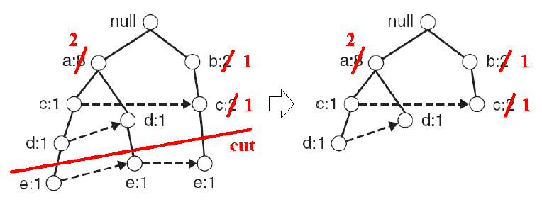
Conditional FP-Tree
To obtain the conditional FP-tree from e from the prefix
sub-tree ending in e :
  1. Update the support counts along the prefix paths
  (from e) to reflect the number of transactions containing e :
  b and c → 1, a → 2
  2. Remove the nodes containing e – information about
  node e is no longer needed because of the previous step

Slide 13
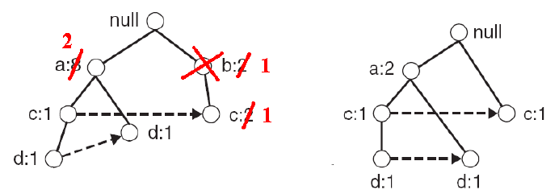
Conditional FP-Tree
  3. Remove infrequent items (nodes) from the prefix paths
  E.g. b has a support of 1 (note this really means be has a support of 1), i.e., there is only 1 transaction containing b and e so be is infrequent can remove b.
Infrequent itemset
=>Min Support=2인데 2보다 작으므로
Conditional FP-tree for e

Slide 14
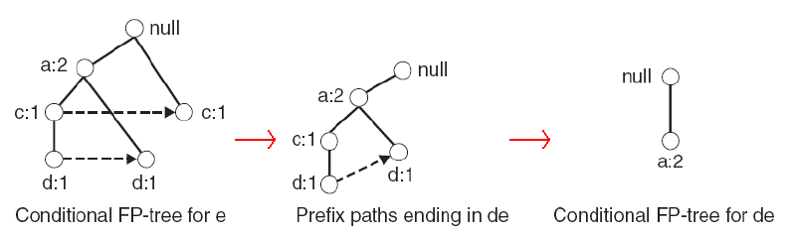
Conditional FP-Tree
  4. Use the conditional FP-tree for e to find frequent itemsets ending in de, ce and ae:
  Note that be is not considered as b is not in the conditional FP-tree for e.
  For each of them (e.g. de), find the prefix paths from the conditional tree for e, extract frequent itemsets, generate conditional FP-tree, etc... (recursively)
  Example: e → de → ade ( {d, e}, {a, d, e} are found to be frequent)

Slide 15
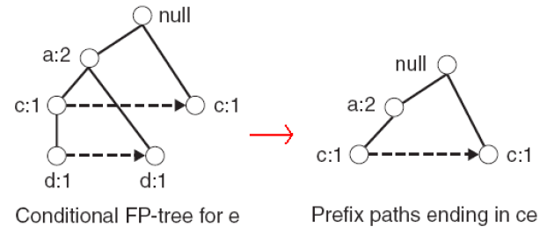

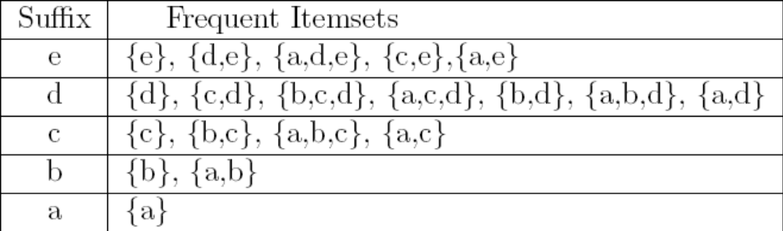
Conditional FP-Tree
  4. Use the the conditional FP-tree for e to find frequent itemsets ending in de, ce and ae: Example: e → ce ({c, e} is found to be frequent)
etc... (ae, then do the whole thing for b,... etc)
Frequent itemsets found (ordered by suffix and order in which they are found)
1
Conditional FP-tree for ce
0

Slide 16
Another Example of Conditional FP-Tree
TID Items bought frequent items
100 {f, a, c, d, g, i, m, p} {f, c, a, m, p}
200 {a, b, c, f, l, m, o} {f, c, a, b, m}
300 {b, f, h, j, o, w} {f, b}
400 {b, c, k, s, p} {c, b, p}
500 {a, f, c, e, l, p, m, n} {f, c, a, m, p}
FP-tree
min_support = 3
{}
Scan DB once, find frequent 1- itemset
Sort frequent items in frequency descending order, f-list
Scan DB again, construct FP-tree
Header Table
item frequency head
f 4
c 4
a 3
b 3
m 3
p 3
f:4
c:1
c:3
b:1
b:1
a:3
p:1
m:2
b:1
F-list = f-c-a-b-m-p
p:2
m:1
Notes:
숙제!! Find frequent item-set

Slide 17
Discussion on FP-Growth
Advantages:
  Only 2 passes over data-set
  Compresses data-set
  No candidate generation
  Much faster than Apriori
Disadvantages:
  FP-Tree may not fit in memory
  FP-Tree is expensive to build
    Trade-off: takes time to build, but once it is built, frequent itemsets are read off easily.
    Time is wasted (especially if support threshold is high), as the only pruning that can be done is on single items.
    Support can only be calculated once the entire data-set is added to the FP-Tree.

Slide 18

FP-Growth vs. Apriori: Scalability
Data set T25I20D10K

